Slide 1

GROUP 2 PROJECT ANALYSIS
GLOBAL SUICIDE
SUICIDE TRENDS ACROSS THE WORLD

Slide 2




Meet the Team
BOBBY HUFFSTETLER
KRISTI MCGRATH
STEFANEE RICHARDSON
TIFFANY TEASLEY
Data Analytics Consultant
Data Analytics Consultant
Data Analytics Consultant
Data Analytics Consultant

Slide 3

Presentation Outline
TODAY'S DISCUSSION
• Data Sources
• Retrieving the Data
• Data Preparation
• Data Exploration
• Summary and Conclusions

Slide 4
DATA SOURCES
Data used to conduct the analysis
Kaggle.com Suicide Rates overview 1985 to 2016 (https://www.kaggle.com/russellyates88/suicide-rates-overview-1985-to-2016?select=master.csv)
Sources for supplemental data and statistics
Datahub (https://datahub.io/JohnSnowLabs/country-and-continent-codes-list#pandas)
National Institute of Mental Health (https://www.nimh.nih.gov/health/statistics/suicide.shtml)
Center for Disease Control and Prevention
World Health Organization

Slide 5
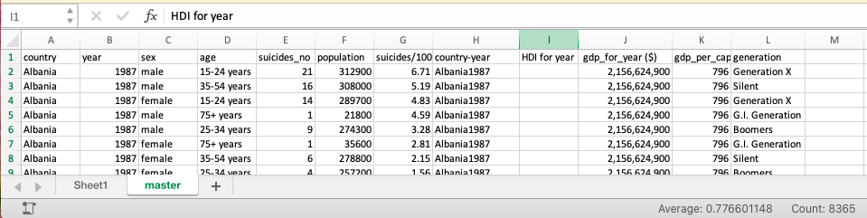
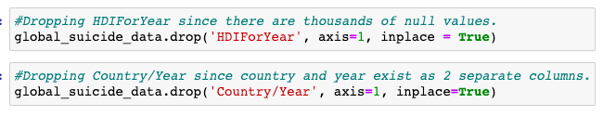
DATA CLEANUP & EXPLORATION

Slide 6
QUESTIONS ABOUT SUICIDE
GLOBALLY
GENDER
AGE
USA
Which age group falls victim to suicide most frequently?
What are the global trends in suicide?
Does gender play a role in suicide?
What are suicide trends in the USA?

Slide 7
What are the global trends in suicide?

Slide 8
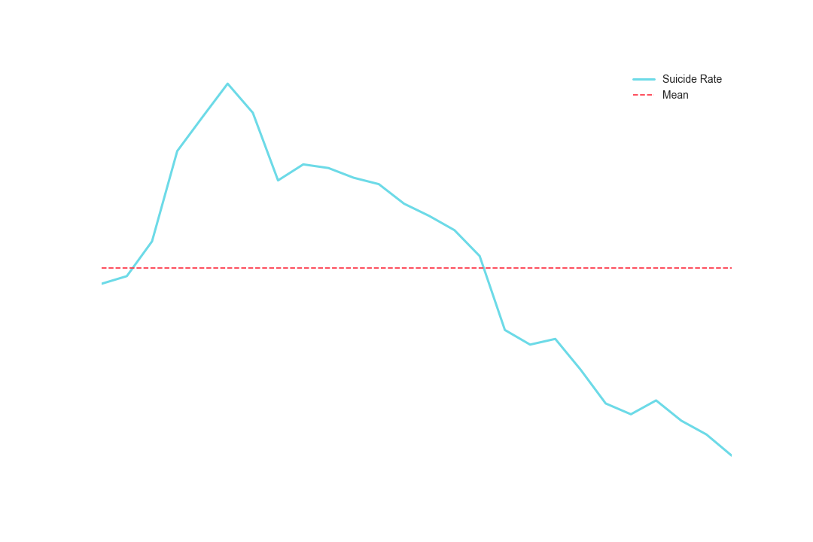
GLOBAL STATISTICS ON SUICIDE
10%
* global target of reducing the suicide rate in countries by 10% by 2020.
20%
*of global suicides are due to pesticide self-poisoning,
79%
*of global suicides occur in low- and middle-income countries
*Statistics obtained from WHO website.

Slide 9
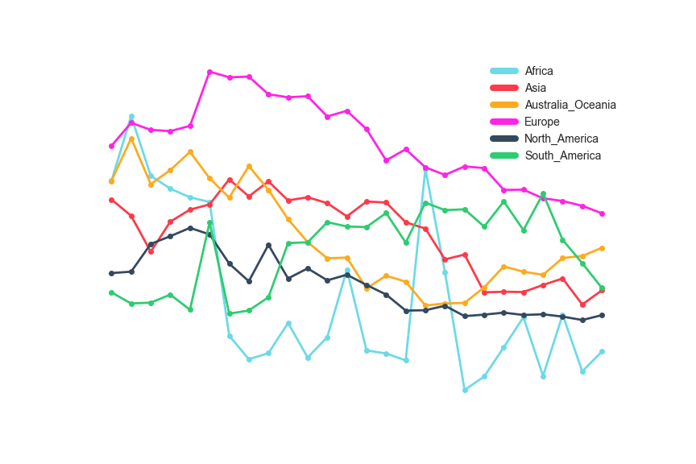
GLOBAL STATISTICS ON SUICIDE

Slide 10
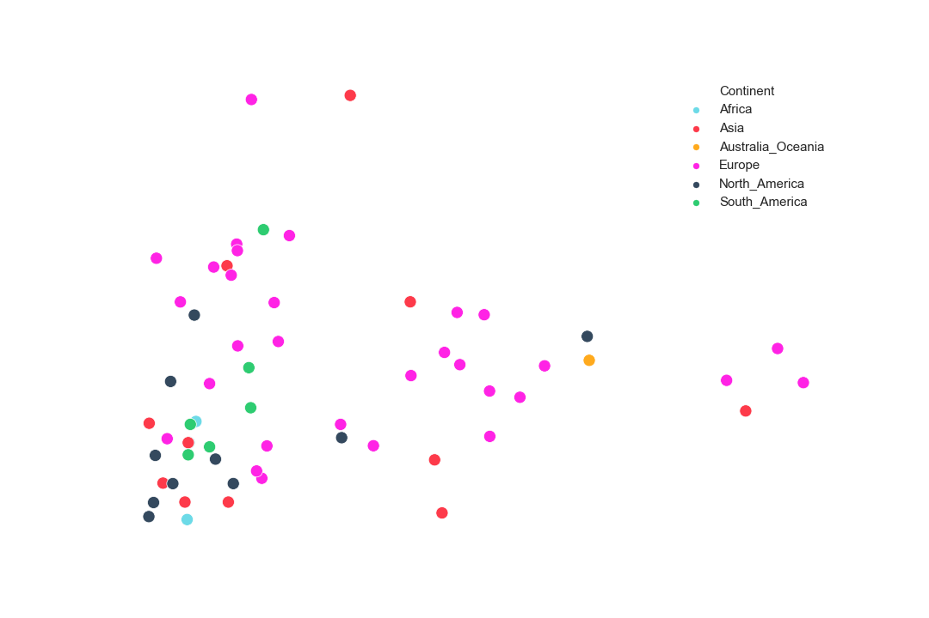
GLOBAL STATISTICS ON SUICIDE

Slide 11
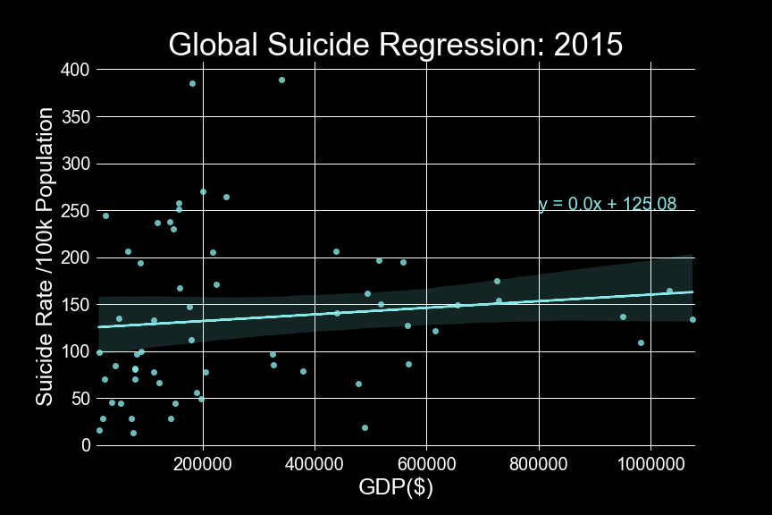
GLOBAL STATISTICS ON SUICIDE
r = .11

Slide 12



GLOBAL STATISTICS ON SUICIDE
SUICIDES PER YEAR
800K
*Close to 800,000 people die due to suicide every year
*Statistics obtained from WHO website.

Slide 13
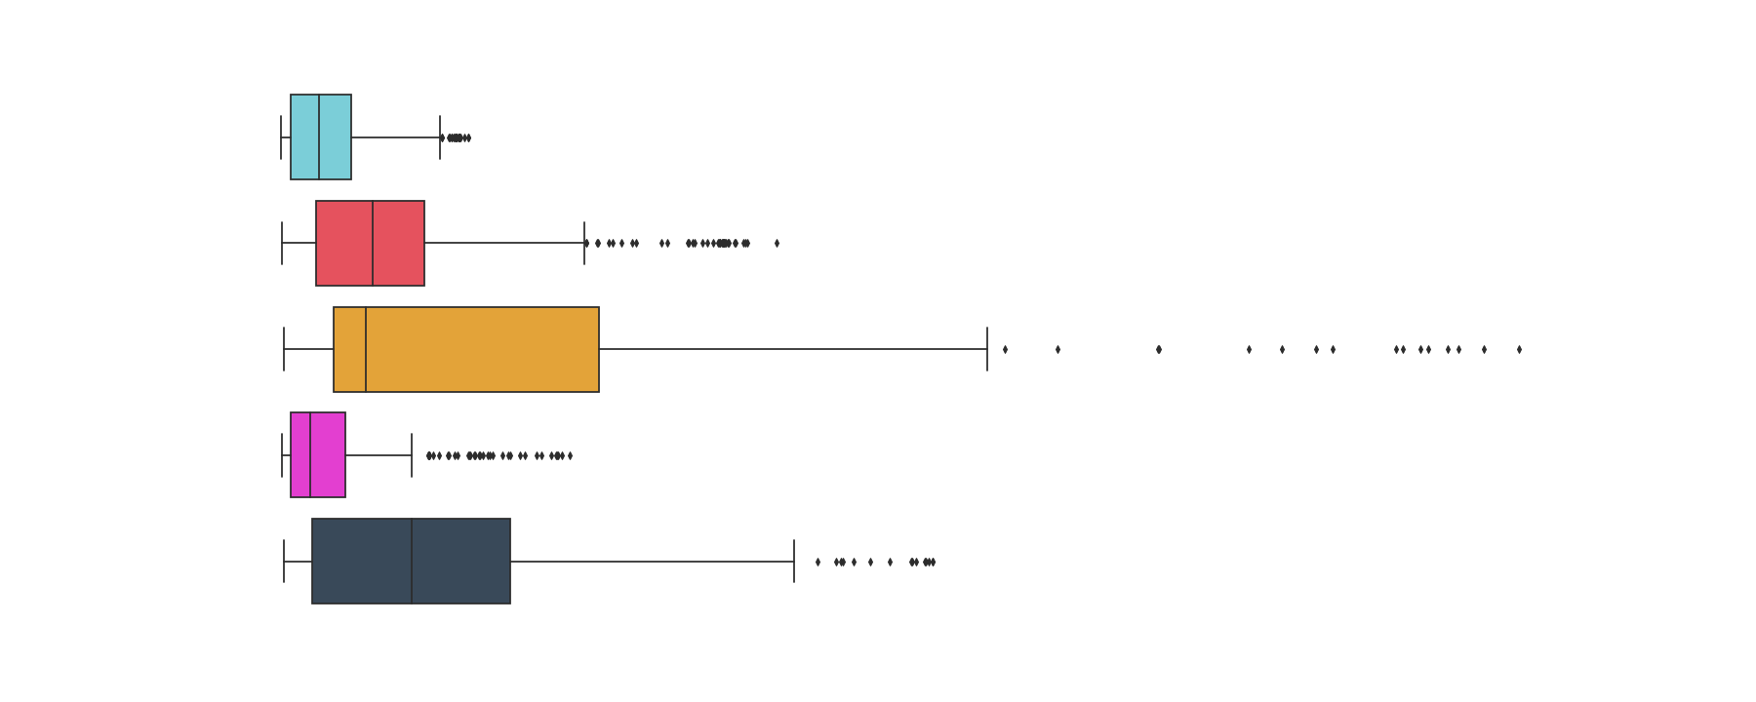
GLOBAL STATISTICS ON SUICIDE

Slide 14
Does gender play a role in suicide?

Slide 15
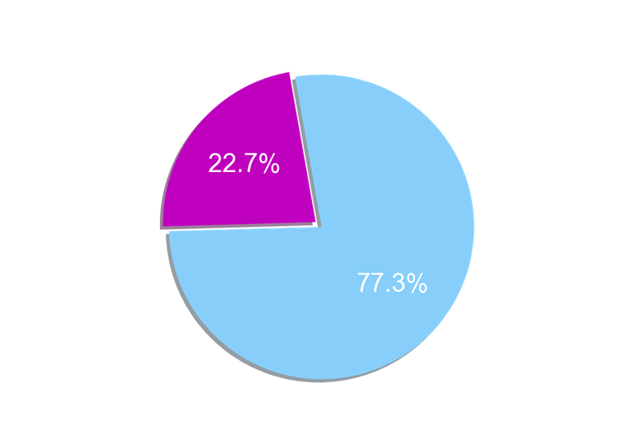
SUICIDE AND GENDER
MALES COMMIT SUICIDE MORE THAN FEMALES
pie chart featuring male and female distribution
*Adult women in the US reported a suicide attempt 1.2 times as often as men.
1.2X
*Statistics obtained from CDC website.

Slide 16
Which age group falls victim to suicide most frequently?

Slide 17


SUICIDE AND AGE
15-19 YEAR OLDS
*Suicide is the third leading cause of death in 15-19-year-olds.
*Statistics obtained from WHO website.

Slide 18
What are suicide trends in the USA?

Slide 19
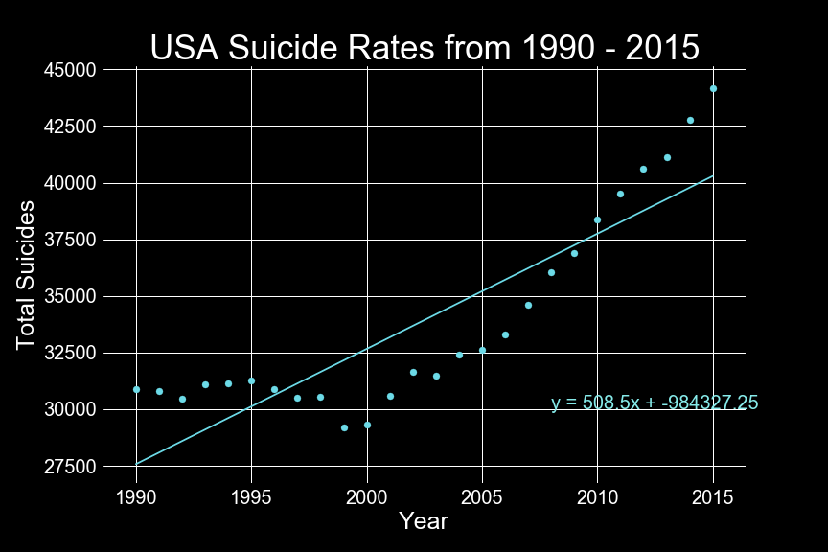
SUICIDE IN THE USA
*Suicide Is the 10th leading cause of death In the US
10th
The correlation coefficient for the number of suicides per year in the United States is 0.87
r=0.87
The prediction value for 2018 Is 41,826
41K
*In 2018, 48,344 Americans died by suicide
48K
*Statistics obtained from CDC website.

Slide 20



SUICIDE AND GENDER IN THE USA T-TEST CODE
independent t-test
H(0): 1 = 2
=.05
statistic 12.663, p-value=.0007
Accept H(A) alternate hypothesis

Slide 21
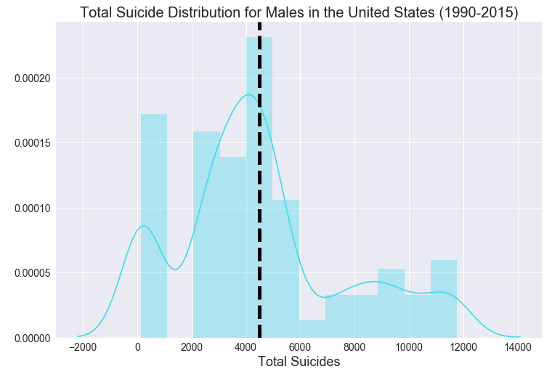
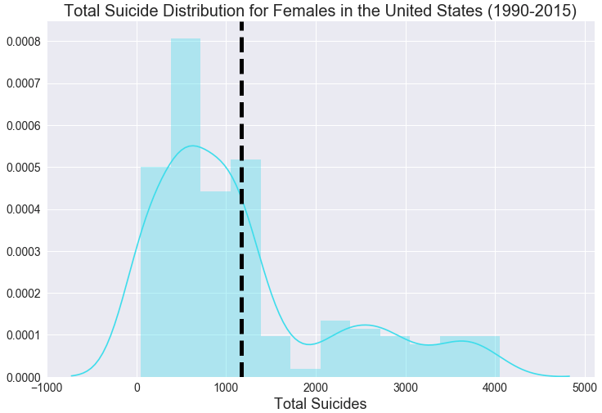
SUICIDE AND GENDER IN THE USA T-TEST
=4490.1
=1165.6

Slide 22
SUMMARY AND CONCLUSIONS
What are the global trends in suicide?
Overall there has been a decrease in global suicides from 1995 to 2015.
Does gender play a role in suicide?
Overall males have a higher rate of suicide compared to females globally.
Which age group falls victim to suicide most frequently?
People aged 75 and older have higher rates of suicide.
What are the suicide trends in the US?
There has been an increase in total suicides in the US from 1990 to 2015.

Slide 23
POST MORTEM
Additional topics we would like to explore:
T-Test - why is there a significant difference in the number of suicides between males and females in the USA?
Human Development Index - there were several null values in the original source data; though this is a key metric when evaluating suicide.
The dataset gave us the "who" and "where." It would be interesting to explore more data that would help us to understand more of the ... "why?"
Challenges:
Developing code as a group (ie merging code in github)

Slide 24

Questions?
SUICIDE PREVENTION RESOURCES
PHONE NUMBER
1-800-273-8255 (TALK)
EMAIL ADDRESS
jo@samaritans.org

